Slide 1
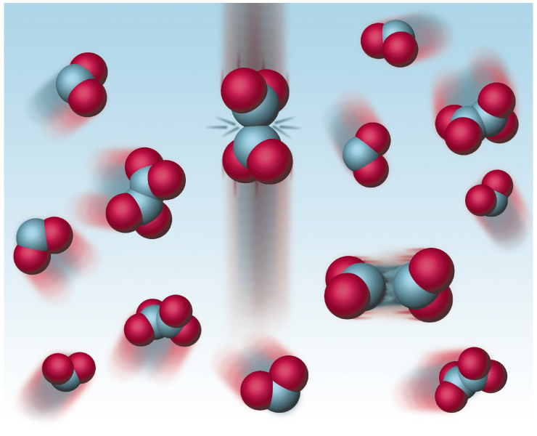
Chemical Equilibrium
&
Le Chatelier's Principle

Slide 2
Many reactions are reversible eg. 2NO₂  N₂O₄
At the same time molecules of NO₂ are reacting to form N₂O₄ molecules N₂O₄ of are involved in bond breaking to form NO₂.

Slide 3
In a reversible reaction chemical equilibrium is reached when the rates of the forward & reverse reactions are equal. At this point the reaction will have constant macroscopic properties (colour, concentration etc). However, on the microscopic scale, the reaction is dynamic.
2 NO₂  N₂O₄

Slide 4
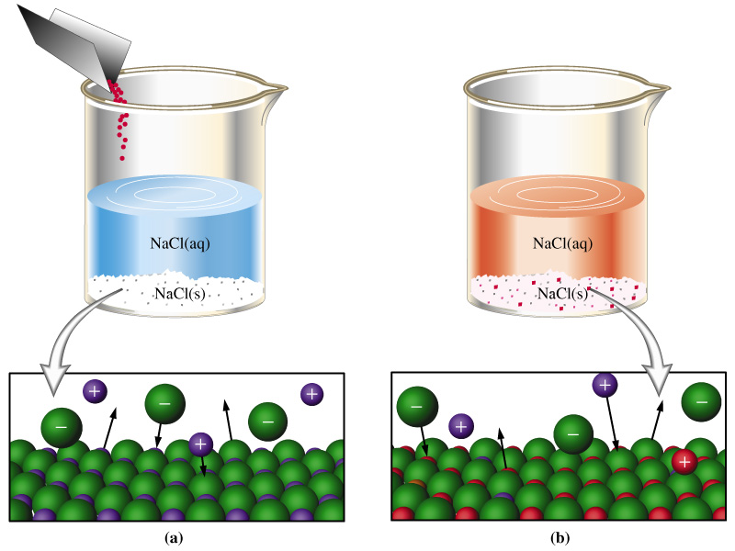
Dynamic equilibrium in saturated solution of sodium chloride.
NaCl_{(s)}  Na⁺_{(aq)} + Cl⁻_{(aq)}
Sodium and chloride ions are constantly entering the solution, but only at the same rate as others are leaving the solution.
As the solution is already saturated, adding more solid has no effect on the forward or reverse reactions.

Slide 5

Links to Dynamic Equilibrium Applets
http://www.chm.davidson.edu/ronutt/che115/EquKin/EquKin.htm
http://mc2.cchem.berkeley.edu/Java/equilibrium/

Slide 6
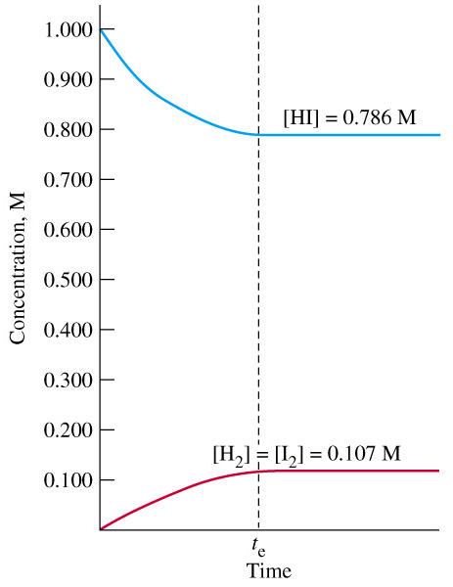
Concentration v’s time graph for the reversible reaction :-
2 Hl_{(g)}  H_{2(g)} + I_{2(g)}
After the time, t_{e}, the reaction is at equilibrium, and the concentrations of reactant and products undergo no further change.
T = 420ºC.

Slide 7
Experiment shows that for a generalised reaction :
aA + bB  cC + dD
Then the equilibrium constant K is given by
K = [C]^{c} [D]^{d}
[A]ª [B]^{b}
where K = equilibrium constant.
[ ] = concentration in mol. L⁻¹
N.B. i. K is for a particular Temperature
ii. Solids and pure liquids (not solutions) are deleted (or taken as 1).
iii. K << 1 = reactants are favoured
K >> 1 = products are favoured

Slide 8
T = 420ºC.
2 Hl_{(g)}  H_{2(g)} + I_{2(g)}
For the above reaction the equilibrium constant K is given by
K = [H₂] [I₂]
[HI]²
= 0.107 x 0.107
0.786²
= 0.0185
N.B. This will only be correct for T = 420ºC.
K

Slide 9
Aa + bB  cC + dD
Before equilibrium is reached the Reaction Quotient Q is given by
Q = [C]^{c} [D]^{d}
[A]ª [B]^{b}
where Q = reaction quotient.
[ ] = concentration in mol. L⁻¹
N.B. This will constantly change until Q = K when equilibrium is reached at time t_{e}.
Q

Slide 10
2 Hl_{(g)}  H_{2(g)} + I_{2(g)}
For the above reaction the reaction quotient Q at the beginning is given by
Q = [H₂] [I₂]
[HI]²
= 0 x 0
1.000²
= 0
Q < K. Hence [H₂] & [I₂] will increase until Q = K (= 0.0185 at 420ºC).
T = 420ºC.
K
Q

Slide 11
In theory, all reactions are reversible to some extent.
However, reactions with a very high K are considered irreversible and reactions with a very low K are effectively no reactions.
Eg1. at 25ºC CO_{(g)} + H_{2(g)}  C_{(s)} + H₂O_{g}
K = 2 x 10¹⁷ considered irreversable
Eg2. At 25ºC N_{2(g)} + O_{2(g)}  2NO_{(g)}
K = 1 x 10⁻³⁰ considered no reaction

Slide 12
Le Chatelier’s principle
“If a chemical system at equilibrium is subjected to a change of conditions, the system will adjust to re-establish in such a way as to partially counteract the imposed change”.
This principle is used to predict the effect of changes to equilibrium systems & will be applied on the next few pages.

Slide 13


Effect of Changing Concentration (1)
2 CrO₄²⁻ _{(aq)} + 2 H⁺_{(aq)}  Cr₂O₇²⁻ _{(aq)} + H₂O _{(l)}
yellow orange
Add H⁺
According to Le Chatelier’s Principle on adding H⁺ the system will re-establish equilibrium in a way which partially counteract the change. Hence the equilibrium will move toward the right and become more orange.

Slide 14
Effect of Changing Concentration (2)
2 CrO₄²⁻ _{(aq)} + 2 H⁺_{(aq)}  Cr₂O₇²⁻ _{(aq)} + H₂O _{(l)}
yellow orange
Add H₂O
Similarly on adding H₂O the system will re-establish equilibrium in a way which partially counteract the change. Hence the equilibrium will move toward the left and become more yellow.

Slide 15
Effect of Changing Concentration (3)
2 CrO₄²⁻ _{(aq)} + 2 H⁺_{(aq)}  Cr₂O₇²⁻ _{(aq)} + H₂O _{(l)}
yellow orange
?
or
?
Challenge Question : Use Le Chatelier’s Principle to predict what would occur if we added some sodium hydroxide to the system.

Slide 16
Effect of Changing Concentration (3b)
2 CrO₄²⁻ _{(aq)} + 2 H⁺_{(aq)}  Cr₂O₇²⁻ _{(aq)} + H₂O _{(l)}
yellow orange
This way since
OH⁻ + H⁺ → H₂O
Answer : Adding sodium hydroxide to the system would neutralise some of the H⁺ so the system would adjust and move toward the left in order to replace some of the H⁺ becoming more yellow.

Slide 17
Effect of Pressure on a Gaseous system
By increasing the partial pressure or reducing the volume, the concentration of any gases is increased. According to the Le Chatelier’s Principle, the system will re-adjust to re-establish equilibrium in such a way as to partially decrease the concentration of the gaseous particles (ie decrease the pressure).
N.B. – If the system contains no gases then pressure does not effect it.

Slide 18
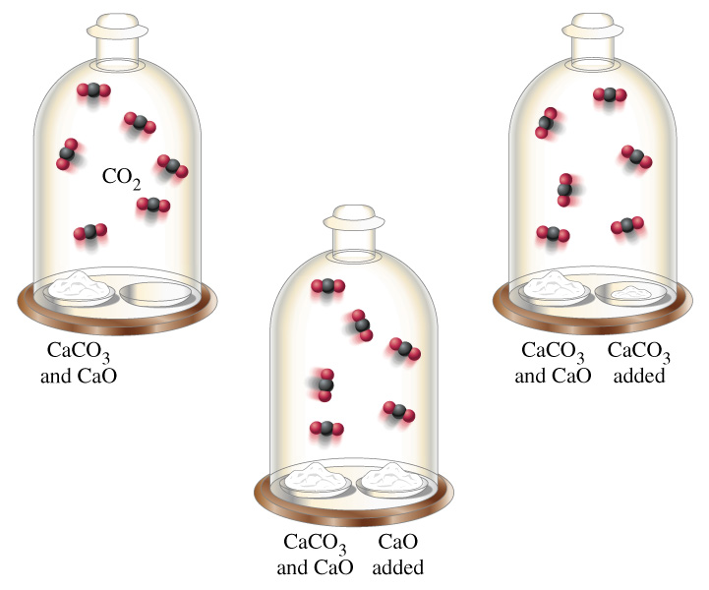
Effect of adding solids to a Gaseous system
Eg. 1 CaCO_{3(s)}  CaO_{(s)} + CO_{2(g)}
When heated in a closed vessel, decomposition of CaCO_{3(s)} yields some CaO_{(s)} and CO₂ _{(g)}. the CO₂ soon exerts its equillibrium partial pressure (top).
Additional CaO has no effect on the partial pressure of the CO₂ (center). Likewise, added CaCO₃ has no effect on the equillibrium partial pressure of CO₂ .

Slide 19
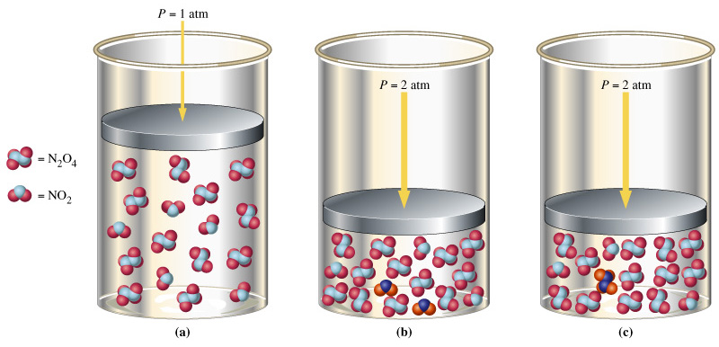
Effect of Pressure on a Gaseous system
eg. 2NO₂  N₂O₄
(a) Equilibrium is established at 1 atm. For every 17 molecules, five are NO₂ and twelve are N₂O₄. (b) The total pressure is increased to 2 atm. Momentarily, the same 17 molecules are present. (c) The system adjusts to partially reduce the pressure. Two of the NO₂ molecules combine to form one N₂O₄ molecule. The new equilibrium has 16 molecules in place of the original 17. Ie. The reaction has moved to the right.

Slide 20
Effect of Pressure on a Gaseous system
eg. 2NO₂  N₂O₄
17 molecules in (a) become 16 molecules in (c).
Hence by the reaction moving to the right, the pressure is partially reduced.

Slide 21
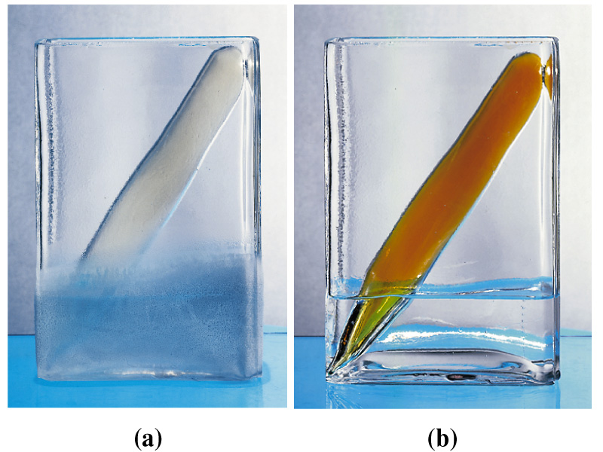
Effect of Temperature on Equilibrium
An increase in temperature increases the rate of both forward and reverse reactions, however the endothermic rate increases more (until equilibrium is again established).
Eg1. Endothermic reaction N₂O₄ + 57kJ  2NO₂
colourless brown
After increasing the temp., the reaction moves to partially decrease the temp. by using up some of the heat favouring the forward reaction.
-150ºC 25ºC

Slide 22
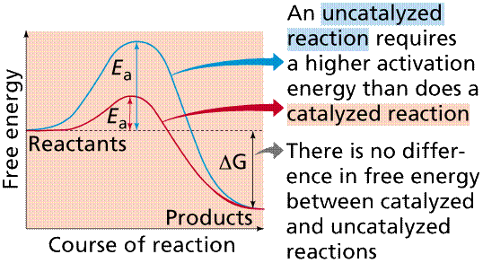
The Effect of Catalysts on Equilibrium
Catalysts lower the activation energy and increase the rate of both the forward and reverse reactions equally and hence do not affect the proportions of reactants or products, so K does not change, ie equilibrium is reached more rapidly but the position is not effected.

Slide 23
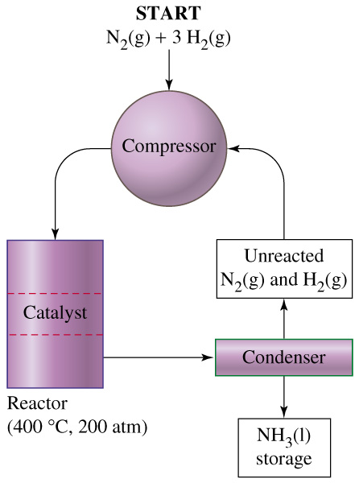
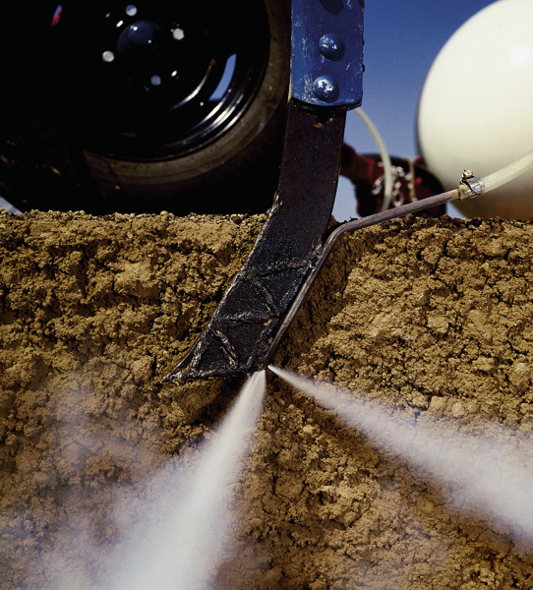
An Industrial Application of Equilibrium
The synthesis of ammonia:
The Haber process Link
http://www.ausetute.com.au/haberpro.html
Use of liquid ammonia as a fertilizer

Slide 24
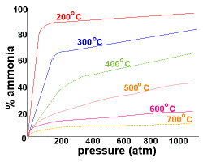

Slide 25
Chromate/Dichromate equilibrium link.
http://www.carlton.paschools.pa.sk.ca/chemical/equilibrium/dichromate/LCP_procedureP.htm

Slide 26
Some Challenge Questions

Slide 27
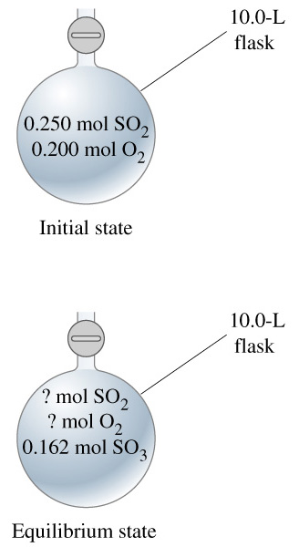
Question 1. How much SO₂ and O₂ are present at equilibrium?

Slide 28
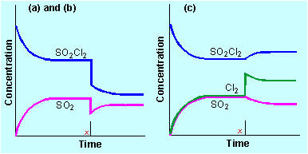
Question 3(a) & (b). SO₂Cl₂ gas is placed into a sealed container and allowed to come to equilibrium for the new temperature.
SO_{2(g)} + Cl_{2(g)}  SO₂Cl_{2(g)}
Answers
The concentrations of the gases are decreased either by removal of some of the gas or by increasing the volume of the container.
The Cl₂ concentration curve will follow that of
the SO₂.

Slide 29
Question 1. How much SO₂ and O₂ are present at equilibrium?
Answer
2 SO₂ + O₂ → 2 SO₃
n(SO₂)_{used} = n(SO₃)_{formed} = 0.162mol
n(SO₂) = n(initial) – n(used)
= n(initial) – n(converted to SO₃) = 0.250 – 0.162 = 0.088mol
n(O₂)_{used} = ½ x n(SO₃)_{formed} = ½ x 0.162mol = 0.081mol
n(O₂) = n(initial) – n(used)
= n(initial) – 0.081 = 0.200 – 0.081 = 0.119mol

Slide 30
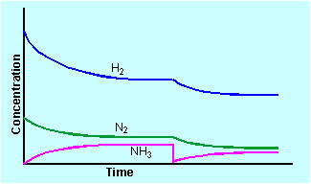
Question 2. Use you knowledge of Le Chatelier’s Principle to explain (a) the changes made to the system below at time t₁, and (b) the subsequent response of the system.
N_{2(g)} + 3H_{2(g)}  2 NH_{3(g)}
t₁

Slide 31
Question 2. Use you knowledge of Le Chatelier’s Principle to explain (a) the changes made to the system below at time t₁, and (b) the subsequent response of the system.
N_{2(g)} + 3H_{2(g)}  2 NH_{3(g)}
t₁
Answer. At time t₁the system was at equilibrium. Ammonia was removed from the system & the system responded by partially replacing the ammonia and hence the reaction moved toward the right.

Slide 32
Question 3(a) & (b). SO₂Cl₂ gas is placed into a sealed container and allowed to come to equilibrium for the new temperature.
SO_{2(g)} + Cl_{2(g)}  SO₂Cl_{2(g)}
Use you knowledge of Le Chatelier’s Principle to explain
the changes made to the system below at time x, and
(b) predict the Cl₂ curve for the system.

Slide 33
Question 3(c). Use you knowledge of Le Chatelier’s Principle to explain the changes made to the system below at time x & explain their effect on the system.
SO_{2(g)} + Cl_{2(g)}  SO₂Cl_{2(g)}

Slide 34
Question 3(c). Use you knowledge of Le Chatelier’s Principle to explain the changes made to the system below at time x & explain their effect on the system.
SO_{2(g)} + Cl_{2(g)}  SO₂Cl_{2(g)}
Answer More chlorine was added to the system thus increasing its concentration. The system responds by trying to partially counteract that change. It reduces the chlorine concentration by consuming some as the reaction moves to the right.

Slide 35
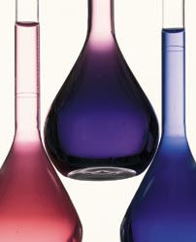
Question 4. Use the information supplied and your knowledge of Le Chatelier’s Principle to predict if this system is endothermic or exothermic. Explain your answer.
25ºC
5ºC
80ºC
Co(H₂O)₆²⁺ + 4Cl⁻  CoCl₄²⁻ + 6 H₂O
Red/Pink Blue

Slide 36
Answer. Increasing the temperature favours the endothermic reaction. Since the forward reaction is favoured it must be the endothermic reaction.
25ºC
5ºC
80ºC
Co(H₂O)₆²⁺ + 4Cl⁻ + heat  CoCl₄²⁻ + 6 H₂O Red/Pink Blue
Or…When the reaction temperature is increasing the reaction moves to partially decrease the temp. by using up some of the heat favouring the forward reaction.

